Slide 1
Incorporating data visualization techniques to showcase historical temperature and humidity trends.

Slide 2
Innovation
Visualizing Temperature and Humidity

Slide 3
To create effective visualizations, you'll need the data and a tool like Python with libraries like Matplotlib or Seaborn for plotting. Here's a general process:
1.Area charts
2.Scatter plots
3.Box plots
4.Line charts
5.Bar charts
6.Heatmaps
7.Dual-Axis charts
8.Animated visualization
9.Geospatial Maps

Slide 4
1.Area Charts:
An area chart or area graph displays graphically quantitative data. It is based on the line chart. The area between axis and line are commonly emphasized with colors, textures and hatchings. Commonly one compares two or more quantities with an area chart.

Slide 5
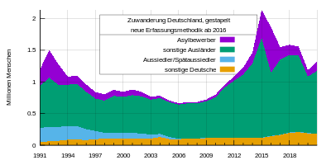
Stacked area chart

Slide 6
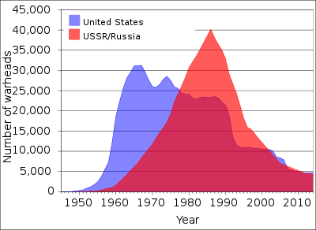
Layered area chart

Slide 7
Various uses of Area charts:
Area charts are used to represent cumulated totals using numbers or percentages (stacked area charts in this case) over time. Use the area chart for showing trends over time among related attributes. The area chart is like the plot chart except that the area below the plotted line is filled in with color to indicate volume.
When multiple attributes are included, the first attribute is plotted as a line with color fill followed by the second attribute, and so on.

Slide 8
2. Scatter plots
Scatter plots can help identify correlations between temperature and humidity. Each point represents a data point with temperature on one axis and humidity on the other. You can add trendlines to illustrate relationships.

Slide 9
Correlation between humidity and temperature
Humidity and temperature are generally positively correlated, meaning as temperature rises, air can hold more moisture, leading to higher humidity. Warmer air can also evaporate water more easily. However, local conditions and geographic factors can influence this relationship

Slide 10
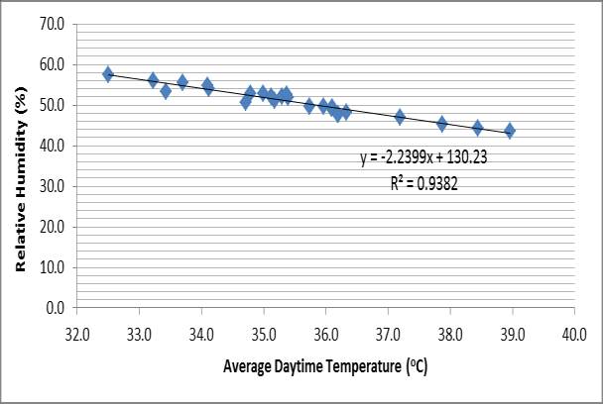
Temperature Vs Humidity

Slide 11
3.Box plots
Box plots can provide a summary of temperature and humidity distributions for each month or season, helping to visualize the spread of data.

Slide 12
1.A boxplot for temperature and humidity would display the median, quartiles, and potential outliers in a concise manner, giving you a snapshot of the central tendency and spread of both variables. It's a handy tool for understanding the distribution characteristics of your data.
2.Box plots are used to show distributions of numeric data values, especially when you want to compare them between multiple groups. They are built to provide high-level information at a glance, offering general information about a group of data's symmetry, skew, variance, and outliers.

Slide 13
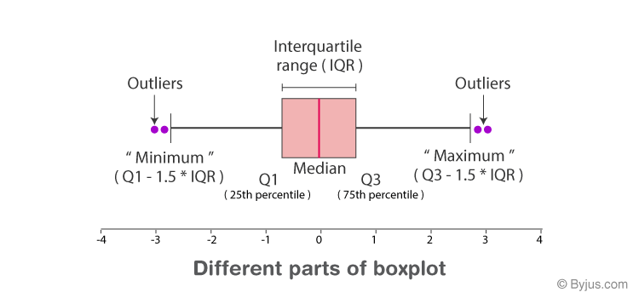

Slide 14
4.Line charts
A line chart or line graph, also known as curve chart, is a type of chart which displays information as a series of data points called ‘markers’ connected by straight line segments.. It is a basic type of chart common in many fields. It is similar to a scatter plot except that the measurement points are ordered (typically by their x-axis value) and joined with straight line segments. A line chart is often used to visualize a trend in data over intervals of time – a time series – thus the line is often drawn chronologically. In these cases they are known as run charts.

Slide 15
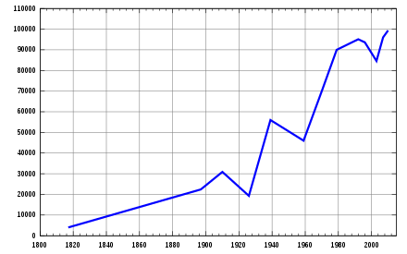
Line chart showing the population of the town of Pushkin, Saint Petersburg from 1800 to 2010, measured at various intervals

Slide 16
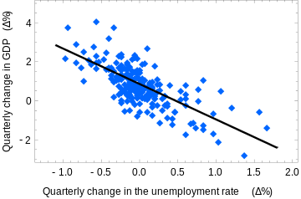
A best-fit line chart (simple linear regression)

Slide 17
5.Bar charts
Bar charts can be used to show monthly or yearly averages of temperature and humidity. Each bar represents a specific time period, and the height of the bar represents the average value.

Slide 18
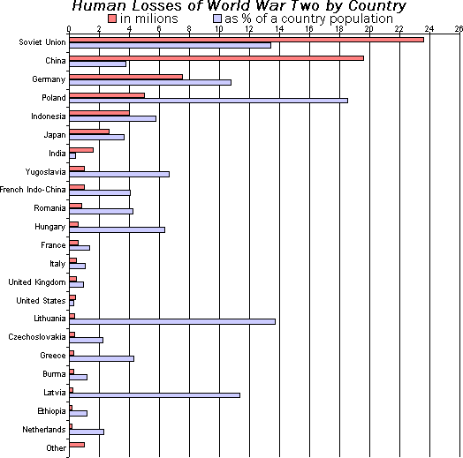
1.A bar chart or bar graph is a chart or graph that presents categorical data with rectangular bars with heights or lengths proportional to the values that they represent. The bars can be plotted vertically or horizontally. A vertical bar chart is sometimes called a column chart.

Slide 19
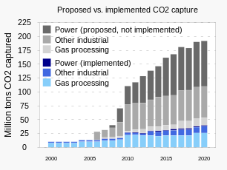
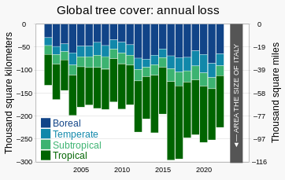
. A vertical stacked bar chart with positive values
A vertical stacked bar chart with negative values

Slide 20
Advantages :
Easy to read and interpret: Bar charts are easy to read and interpret, even for people without a background in statistics or data visualization. The bars make it easy to compare values and see trends, making it a useful tool for communicating information to a wide range of audiences.
Can handle large amounts of data: Bar charts can handle large amounts of data and still provide a clear representation of the information. The bars can be made narrow or wide to fit a large number of categories or data points, and the use of color or patterns can make it easier to distinguish between them.
Customizable: Bar charts can be customized to suit the needs of the user. For example, the color, width, and height of the bars can be adjusted to make the chart more visually appealing, and labels and annotations can be added to provide additional information.
Useful for comparing values: Bar charts are particularly useful for comparing values between categories or data points. They allow for quick identification of differences and similarities, making it easy to draw conclusions and make decisions.

Slide 21
6.Heatmaps
Heatmaps can visualize temperature and humidity simultaneously. Use a color scale to represent different temperature and humidity levels on a grid, with time intervals on one axis and days or months on the other.

Slide 22
There are two main type of heat maps
spatial
grid
A spatial heat map displays the magnitude of a spatial phenomena as color, usually cast over a map. In the image labeled “Spatial Heat Map Example,” temperature is displayed by color range across a map of the world. Color ranges from blue (cold) to red (hot).
A grid heat map displays magnitude as color in a two-dimensional matrix, with each dimension representing a category of trait and the color representing the magnitude of some measurement on the combined traits from each of the two categories. For example, one dimension might represent year, and the other dimension might represent month, and the value measured might be temperature.

Slide 23
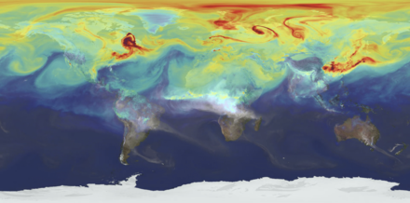
Spatial Heat Map Example: Displays temperature across a world image with red being the highest and blue being the lowest degree in temperatures

Slide 24
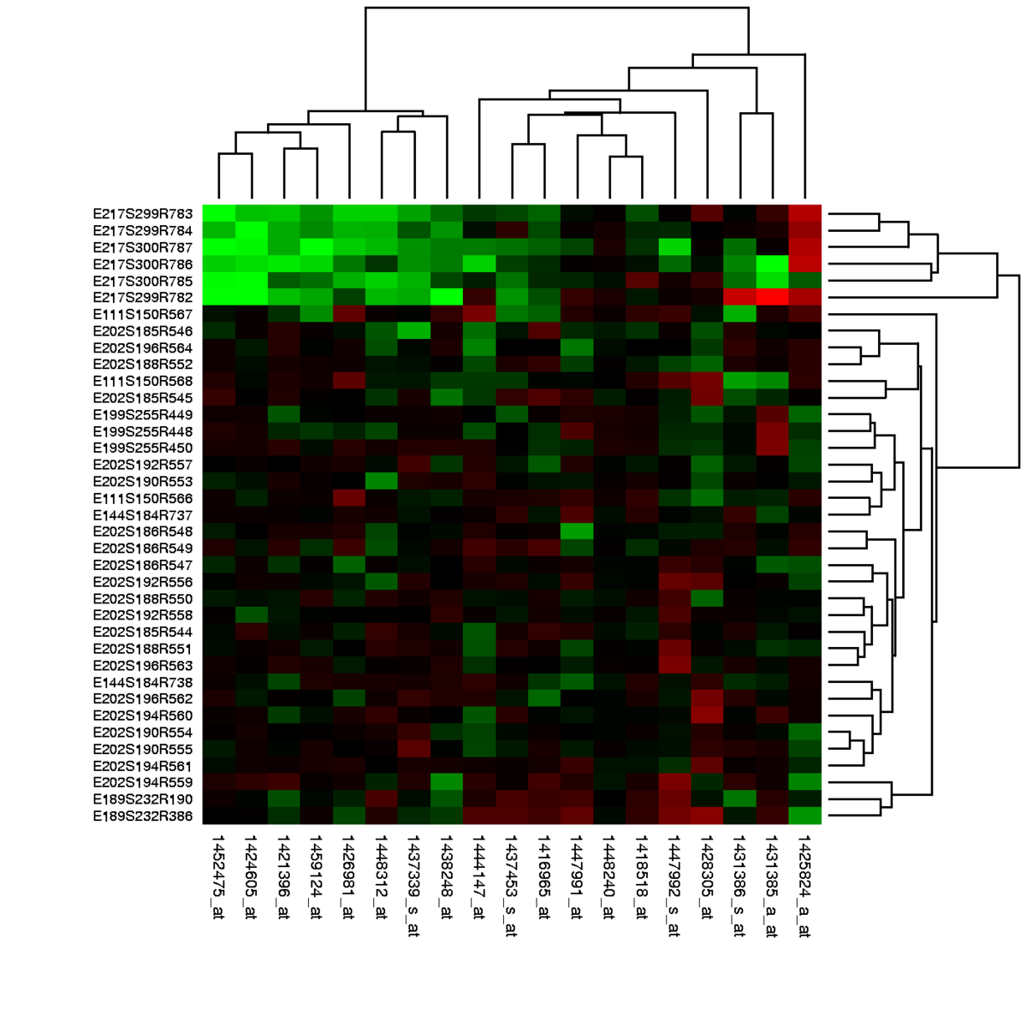
A Grid heat map displays magnitude as color in a two-dimensional matrix, with each dimension representing a category of trait and the color representing the magnitude of some measurement on the combined traits from each of the two categories.

Slide 25
7.Dual-Axis charts
Combine line or bar charts with dual y-axes to display temperature and humidity on the same graph. This allows us to compare trends easily.

Slide 26
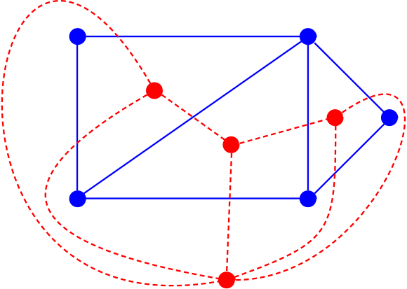
The red graph is the dual graph of the blue graph, and vice versa.

Slide 27
Dual axis in a graph allows you to represent two sets of data on different scales. In humidity and temperature distribution, it could help visualize their relationship more effectively.dual axes for humidity distribution lets you compare two related metrics, like humidity levels at different locations or times. It provides a clear way to see any patterns or correlations between them.

Slide 28
8.Animated visualization
If you have data over a long period, consider creating animated visualizations to show how temperature and humidity change over time. This can be done using line charts or heatmaps.

Slide 29
Creating a 3D visualization of humidity and temperature distribution involves representing these variables in a three-dimensional space. You'd likely use a software tool or programming language like Python with libraries such as Matplotlib or Plotly for this.To visualize humidity and temperature distribution in 3D, you can use Python with libraries like Matplotlib and Plotly. Matplotlib's mplot3d toolkit or Plotly's 3D scatter plots can be handy. You'll need a dataset with humidity, temperature, and corresponding spatial coordinates.

Slide 30
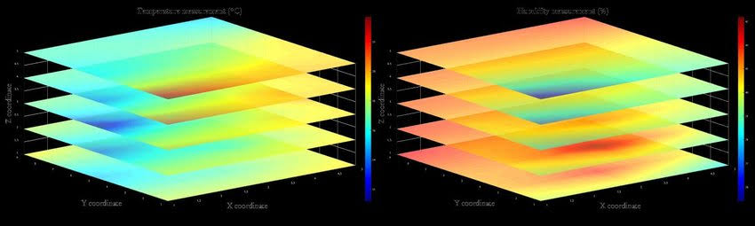
3D visualization of temperature and humidity

Slide 31
9.Geospatial maps
If you have location-based data, you can create maps that display temperature and humidity trends across different regions. Color-coding can represent different values.

Slide 32
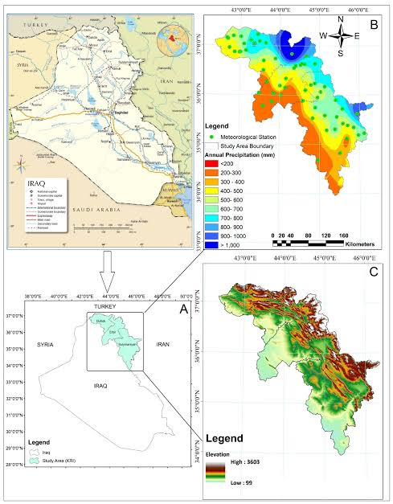
A Geospatial Approach for Analysis of Drought Impacts on Vegetation Cover and Land Surface Temperature

Slide 33
Geospatial maps to enhance articles, providing visual context to geographical or historical information. These maps can offer a clearer understanding of topics like historical events, demographics, or geographic features.Geospatial maps can visually represent humidity and temperature variations across different locations, helping to analyze and understand climate patterns.

Slide 34
Sensors used for sensing the humidity and temperature
Temperature and humidity sensors are among the most commonly used environmental sensors. Humidity sensors are also sometimes referred to as hygrometers. These devices are used to provide the actual humidity condition within the air at any given point or in any given place.

Slide 35
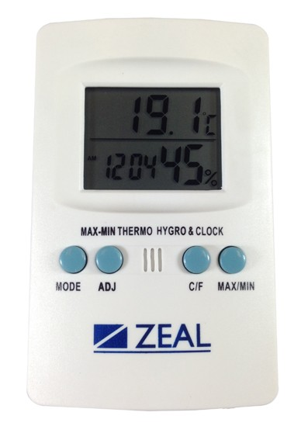
Thermo -Hygrometer
The Thermo-Hygrometer model PH1000 displays humidity over the range of 10 to 99%rh and temperature over -50 to + 70°C or equivalent °F with a 0.1°C/°F resolution. It also incorporates a 12/24 hour clock.
TEMPERATURE AND HUMIDITY DIGITAL
(THERMO-HYGROMETER)

Slide 36
Thank you
These are the topics of phase-2(INNOVATION)
Submitted By :
Swetha.B
Reg no: 422621104046
Environmental Monitoring

